Slide 1
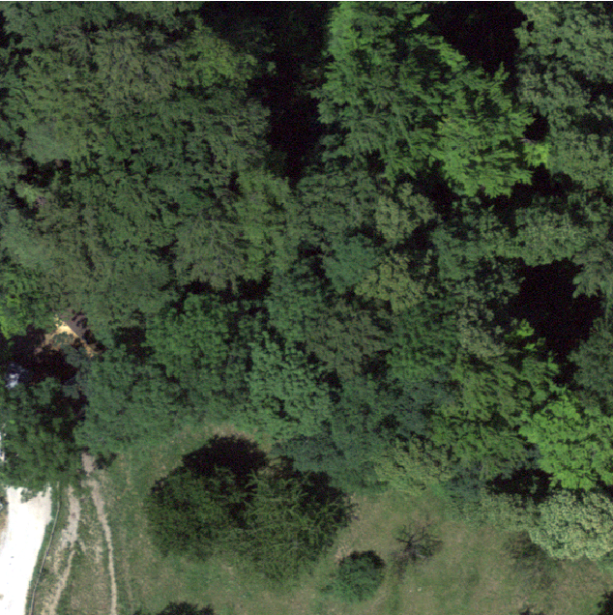
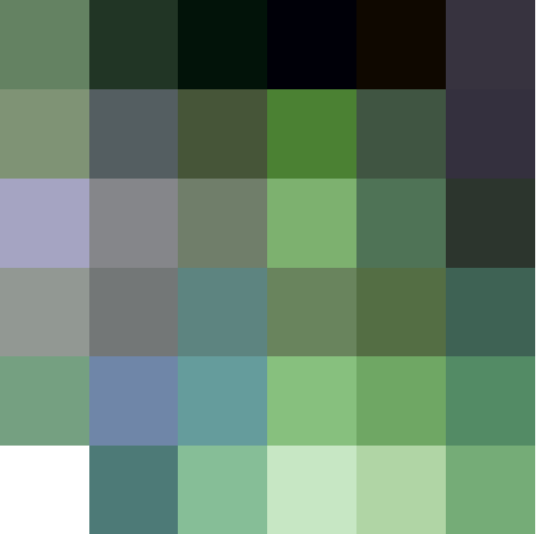


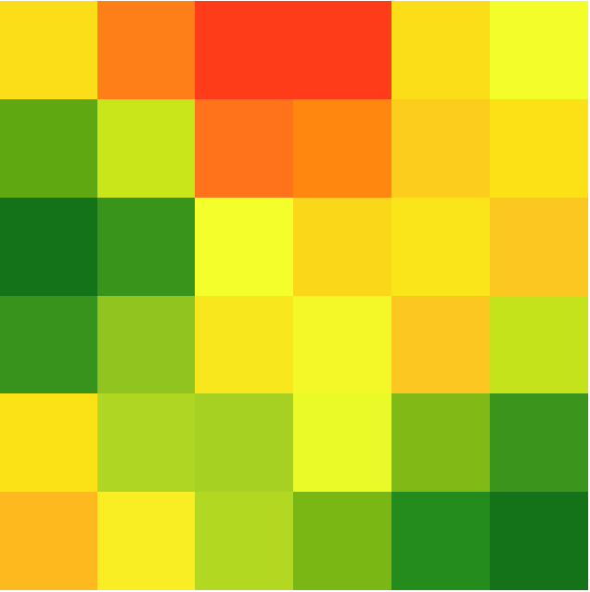
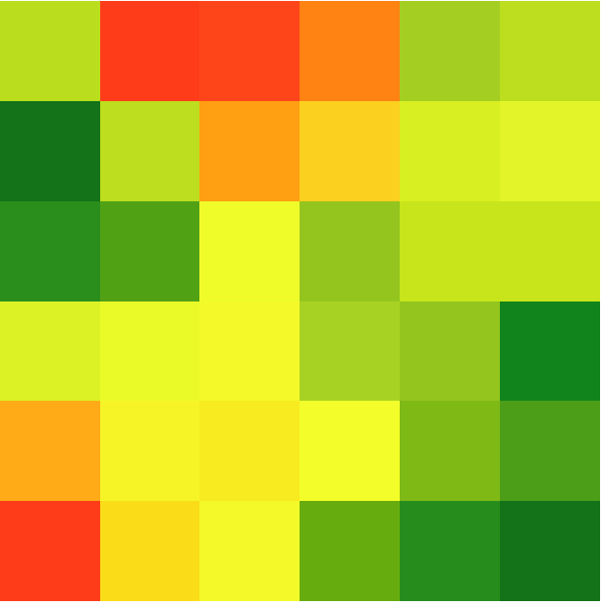


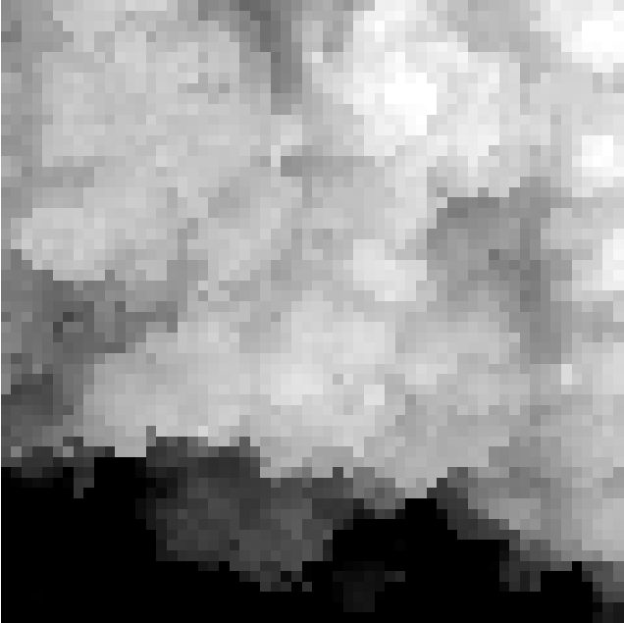
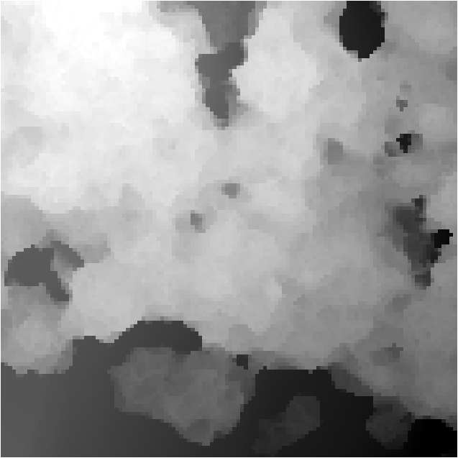
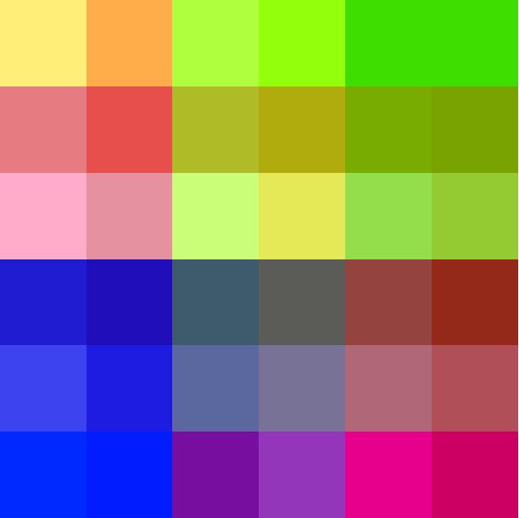










Resample
UAV Image
$\frac{H}{2}$ × $\frac{W}{2}$ @0.2m/px
Dense Feature Map
Downsample
H × W @0.1m/px
AnySat
$$ℝ^{256×30×30}$$
Sub-patch = 10m
Sentinel 2-TS
$$ℝ^{1536×30×30}$$
Gated Unit
$$P_{3}$$
Sub-patch = 10m
Sentinel 1-TS
$$P_{4}$$
DINO Detector
$$P_{5}$$
VHM Encoder
$$P_{6}$$
DEM
FPN
VHM
M L P
DSM
…
Climplicit
broadcast
$${Flatten to ℝ}^{(36, 64)}$$
(Lat, Lon, Year)
…
…
$${embedding∈ℝ}^{256}$$
Google Satellite Embedding
$$ℝ^{256×30×30}$$

Slide 2
Training Details and Evaluation
Dataset is sparsely labeled, so we ignore unlabeled regions -> ignore negative samples
  DINO Detector: Apply Masking Strategy
2. Sparse (Precision + Recall + F1 + AP) and confusion matrix
IoU > 0.5 and correct species -> True positive
IoU > 0.5 and wrong species -> False positive
Labeled GT did not match any bbox -> False Negative

